Slide 1
Emmanuel Disability Ministry
Duane Anderson, MD
Soddo Wollaita Ethiopia
April 2020

Slide 2
Emmanual Disability Ministry
Founded by Melese Eyob in 2015
Supported by the Ethiopian government because of its ability to give jobs to the disabled and get people off the streets
Ministry and jobs for Men & Women

Slide 3
14 years ago Melese Eyob, disabled street boy
He asked for a free ride from a bus driver from Kambatta because Dr Kelemu gave him a free set of crutches
He needed a new set
I needed patients

Slide 4
He asked for crutches, I gave him surgery
After his first surgery
He liked SCH better than the street

Slide 5
After his second or third surgery
He cried went I sent him back on the street
So I gave him a job

Slide 6
14 year old employee of SCH
Since I was the director of the hospital I could do that in those days
He started making my Rush rods and anything I asked him to do
He took disabled women to get their braces made in Arba Minch

Slide 7
Entrepeneur
So he decided that he needed to help the other disabled people in the southern nations
He asked the gov’t for a ware house
They gave it to him
Now he has many employees, mostly disabled

Slide 8
Disabled welders & metaworkers

Slide 9
Disabled wood workers

Slide 10
Hospital beds and bunk beds

Slide 11
Wood and metal crutches

Slide 12
Trikes and wheelchairs

Slide 13
Fixing motorycles!

Slide 14
Hospital beds and stretchers

Slide 15
Portable toilets and walkers

Slide 16
Cabinets and mini shops

Slide 17
Sewing and basket weaving

Slide 18
Now he has two warehouses
Women
Baking
Cooking
Weaving
sewing
Men
Welding
Fabricating
Weaving
woodworking

Slide 19
Melese’s partners
Baracut, degree in metal fabrication
Dr A, Mentor

Slide 20
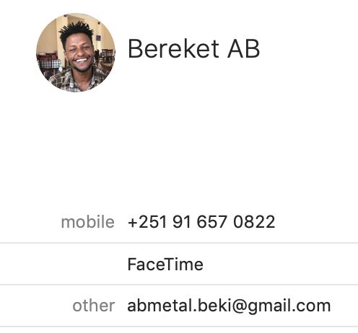
Help your self and the disabled
Crutches
Stretchers
Toilets
Walkers
Orthopedic hospital beds

